Slide 1
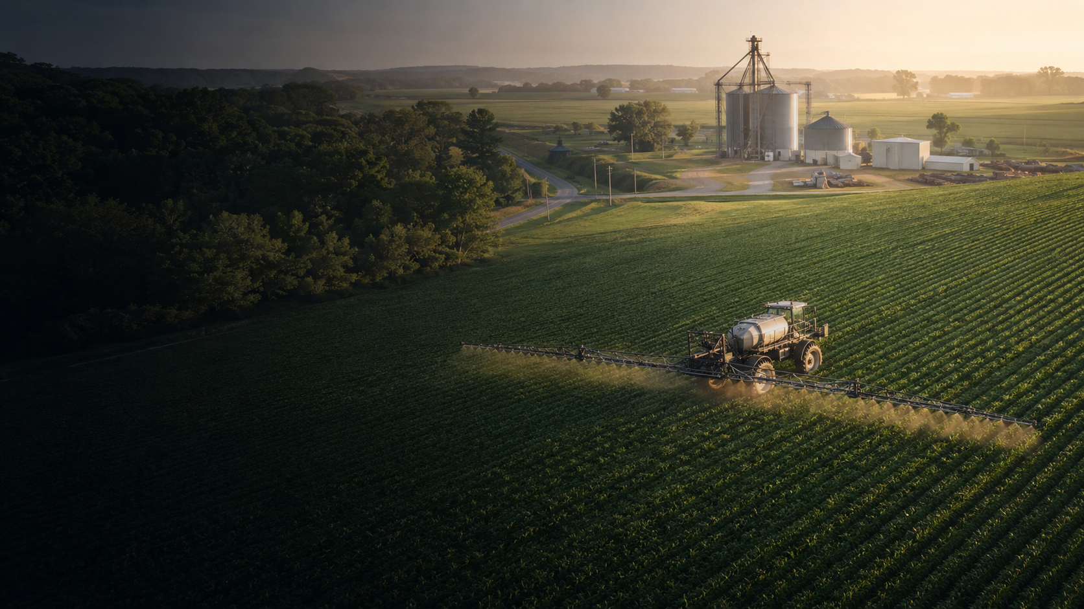
BUILDING A STRONGER
COOPERATIVE FUTURE
A member-owned vision for West Tennessee agriculture
Obion • Weakley • Henry
SPECIAL CALLED MEMBERSHIP MEETING
Notes:
Open by emphasizing that this discussion begins from strength and stewardship—not crisis.
[Sources]
- OpenAI-generated agricultural image, July 31, 2026.

Slide 2



WHAT COOPERATIVES WOULD MERGE?

Slide 3
WHY WE ARE HERE
This is not failure. It is foresight.
Each cooperative has served its members well. The responsibility before us is to recognize how agriculture is changing—and act while we have choices.
STRONG
TODAY
Prepared
for tomorrow
OBION • WEAKLEY • HENRY
Notes:
Pause after the opening sentence. Make clear that successful organizations plan before pressure removes their options.

Slide 4
THE DECISION
Together, we can build a stronger cooperative.
Can three locally rooted cooperatives create greater member value, stronger service, and better long-term protection than each can create alone?
That is the standard by which this proposal should be judged.
OBION • WEAKLEY • HENRY
Notes:
Frame the merger as a member-value decision, not an organizational preference.

Slide 5
WHY NOW
Agriculture has changed—and scale now matters.
Tighter margins
Larger competitors
More pressure on every operating dollar.
Scale increasingly shapes cost and capability.
Expensive technology
Higher expectations
Modern systems require continuing investment.
Members need speed, expertise, inventory, and reliability.
Standing still is also a decision—and it carries risk.
OBION • WEAKLEY • HENRY
Notes:
Connect each external change directly to service on the farm. Avoid criticizing the past; the point is that the environment has changed.

Slide 6
OUR COMBINED FOUNDATION
Together, three cooperatives create meaningful regional scale.
3
ONE
SHARED
member-owned cooperatives
regional network
capacity & expertise
Scale does not replace local relationships. It gives those relationships stronger support.
OBION • WEAKLEY • HENRY
Notes:
Use the three-cooperative footprint to show that the foundation for regional scale already exists.

Slide 7
THE OPPORTUNITY
Three local legacies. One stronger regional organization.
OBION
WEAKLEY
HENRY
ONE MEMBER-OWNED COOPERATIVE
Shared strength • Local service • Farmer governance
The goal is not sameness. The goal is shared capacity.
OBION • WEAKLEY • HENRY
Notes:
Explain that the new organization combines resources without erasing the communities, people, and relationships members rely on.

Slide 8
WHAT WE ARE PRESERVING
The merger protects the cooperative model.
FARMER OWNERSHIP
Members remain the owners.
LOCAL SERVICE
People and facilities remain close to the farm.
MEMBER VALUE
Savings and strength flow back to members.
LONG-TERM STEWARDSHIP
Decisions protect the next generation.
OBION • WEAKLEY • HENRY
Notes:
This is the values slide. Emphasize that structure may change so the cooperative purpose can endure.

Slide 9
PURCHASING POWER
Greater purchasing scale strengthens every negotiation.
More volume
Stronger terms
More member value
Larger commitments can improve vendor discussions, inventory access, freight efficiency, and supplier attention.
Every sustainable dollar gained belongs to the membership.
OBION • WEAKLEY • HENRY
Notes:
Avoid promising a specific price reduction. Explain the mechanisms through which scale improves the cooperative's negotiating position.

Slide 10
ADMINISTRATIVE EFFICIENCY
Shared systems let us spend less on duplication.
TODAY
FUTURE STATE
Three audit programs
→
One coordinated audit approach
Three software environments
→
One modern technology platform
Three insurance programs
→
One stronger risk program
Three reporting structures
→
One shared administrative team
Efficiency means more resources available for service, equipment, people, and member returns.
OBION • WEAKLEY • HENRY
Notes:
Describe these as categories of opportunity. Actual consolidation decisions require detailed integration planning.

Slide 11
OPERATIONAL EFFICIENCY
A regional network can use resources better.
Fleet & equipment
Inventory
Coordinate specialized assets across a wider territory.
Improve availability while reducing unnecessary duplication.
Logistics
Specialists
Plan deliveries, transfers, and seasonal capacity as one network.
Share agronomy, safety, finance, and technology expertise.
OBION • WEAKLEY • HENRY
Notes:
Give local examples only if the facts are final. The principle is that a network can place scarce resources where member demand is highest.

Slide 12
A STRONGER BALANCE SHEET
Financial strength gives a cooperative more choices.
MORE
GREATER
BETTER
working capital
borrowing capacity
resilience
A stronger organization can invest through difficult cycles—not merely react to them.
OBION • WEAKLEY • HENRY
Notes:
Tie balance-sheet strength to member service: inventory, equipment replacement, seasonal financing, and the ability to withstand difficult years.

Slide 13
WHERE THE VALUE GOES
Efficiency only matters when it becomes member value.
COMPETITIVE
PRICING
BETTER
SERVICE
MODERN
EQUIPMENT
PATRONAGE
& EQUITY
The objective is not simply to reduce cost. It is to create more value for every member-owner.
OBION • WEAKLEY • HENRY
Notes:
This is the bridge from efficiency to purpose. Keep the discussion focused on member outcomes.

Slide 14
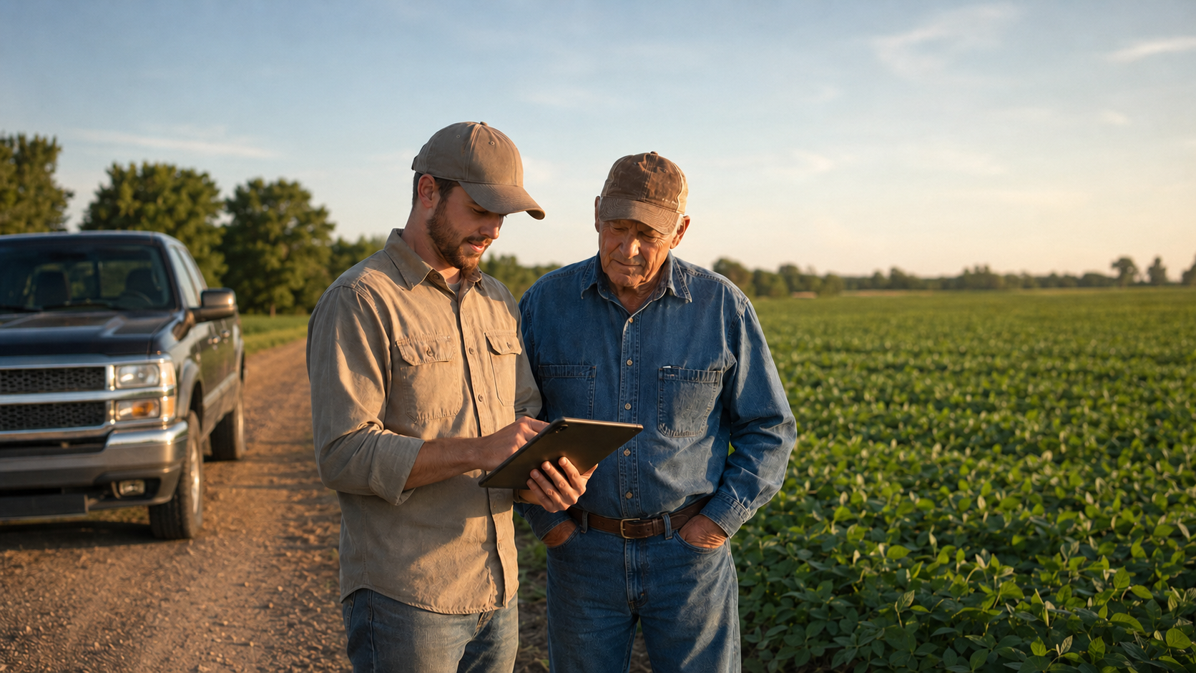
LOCAL SERVICE
STAYS LOCAL.
Local employees.
Local agronomy knowledge.
Local relationships.
Farmer-elected leadership.
A stronger organization stands behind them.
OBION • WEAKLEY • HENRY
Notes:
Reassure members that scale is the support structure behind local service—not a substitute for it.
[Sources]
- OpenAI-generated agricultural image, July 31, 2026.

Slide 15
LOCAL CONTROL
Governance remains in the hands of farmers.
MEMBERS
elect
DIRECTORS
who govern
THE COOPERATIVE
Each legacy cooperative will share equal representation on the Board of Directors
OBION • WEAKLEY • HENRY
Notes:
State the proposed board composition and transition terms here once approved. Do not leave members guessing about representation.

Slide 16
MEMBER EQUITY
Protecting member equity is a central reason to act.
Preserve value
Support retirement
Build the earnings capacity that supports the cooperative's obligations.
A stronger, sustainable business is better positioned to retire equity over time.
Member equity
Opportunity for success
Member equity accounts transfer and remain intact.
Stronger balance sheets and margins put the cooperative in the best position to protect your equity. Protecting member equity is atop the list of priorities while working through this merger study.
OBION • WEAKLEY • HENRY
Notes:
Only make commitments consistent with the final merger agreement, bylaws, and legal advice. Replace general language with exact approved terms before the meeting if available.

Slide 17
TALENT & SUCCESSION
Scale helps us attract and retain the best employees.
1
2
3
4
5
Clear career paths
Specialized roles
Stronger training
Better benefits
Leadership succession
Better-supported employees deliver better service to members.
OBION • WEAKLEY • HENRY
Notes:
Connect organizational scale to retention and recruitment. Members experience this benefit through continuity, expertise, and faster problem-solving.

Slide 18
TECHNOLOGY
Modern service requires modern technology.
Precision application
Invest in accuracy and capacity.
Customer tools
Improve access to account and field information.
Data & cybersecurity
Protect information and strengthen controls.
Inventory visibility
See and move products across the region.
OBION • WEAKLEY • HENRY
Notes:
Technology is not an optional extra. It is now part of reliable agronomy, customer service, accounting, and risk management.

Slide 19
LONG-TERM RESILIENCE
Scale helps us weather agriculture's cycles.
STRONG YEARS
TIGHT YEARS
RECOVERY
Invest and build reserves
Absorb pressure and protect service
Move quickly when opportunity returns
The objective is consistent service, and sustainable member returns across the full cycle.
OBION • WEAKLEY • HENRY
Notes:
Agriculture will always be cyclical. The strategic question is whether the organization has the diversity, liquidity, and capacity to manage those cycles.

Slide 20
THE MEMBER EXPERIENCE
Members should feel a stronger network—not more distance.
More dependable availability
Faster problem solving
A regional view of products and capacity.
Broader expertise available to local teams.
Consistent systems
Deeper local capability
Clearer processes across every location.
Stronger tools behind the people members know.
Success will be measured at the farm gate—not in the home office.
OBION • WEAKLEY • HENRY
Notes:
This slide defines the practical promise. Members should judge success through responsiveness, availability, expertise, and trust.

Slide 21
CLEAR EXPECTATIONS
What this merger does—and does not—mean.
IT DOES MEAN
IT DOES NOT MEAN
✓ A stronger shared balance sheet
— Abandoning cooperative values
✓ Coordinated purchasing and operations
— Replacing farmer governance
✓ One member-owned regional organization
— Ignoring local relationships
✓ More capacity behind local service
— A promise that nothing will ever change
OBION • WEAKLEY • HENRY
Notes:
Be honest: integration will involve change. The commitment is that change will be evaluated through member value and service, not convenience alone.

Slide 22
FREQUENTLY ASKED QUESTIONS
Members deserve direct answers.
Is someone in trouble?
No. This is a proactive discussion from a position of combined strength.
Will local people still be here?
Local relationships remain essential to success.
Will prices increase?
The goal is stronger purchasing and operating efficiency—not added cost.
What happens to my equity?
All equity held by members of the three participating cooperatives will transfer to and remain intact with the merged cooperative. Protecting member equity—and sustaining the ability to revolve it over time—remains a top priority throughout the merger process.
OBION • WEAKLEY • HENRY
Notes:
Invite questions. If a detail is not final, say so and commit to answering it before members are asked to decide.

Slide 23
THE NEXT GENERATION
Our duty is to strengthen what we inherited.
The question is not whether the cooperative of the past was successful.
It was.
The question is what structure gives the next generation the best chance to succeed.
OBION • WEAKLEY • HENRY
Notes:
End the argument on stewardship. This is about handing the next generation a cooperative strong enough to serve them.

Slide 24
STRONGER TOGETHER.
LOCAL BY DESIGN.
MEMBER-OWNED ALWAYS.
Building a cooperative future worthy of West Tennessee agriculture.
OBION • WEAKLEY • HENRY
Notes:
Close with confidence, then pause. Invite the membership's questions and discussion.

